Slide 1
Press Clippings
Pepe Jeans Footwear
September & October 12
France

Slide 2
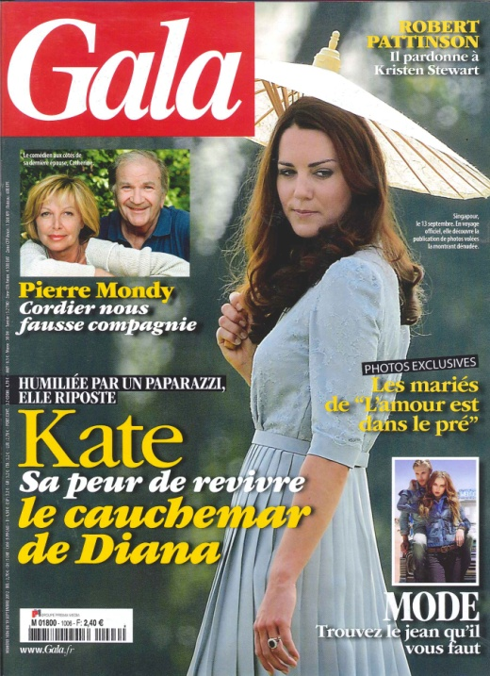
PUBLICATION : GALA
ISSUE: 19 SEPTEMBER
CIRCULATION: 2 964 000
PAGE RATE: 21 400
PRODUCT:

Slide 3
PUBLICATION : VERSION FEMINA
ISSUE: 10-16 SEPTEMBER
CIRCULATION:10 078 000
PAGE RATE: 75 400
PRODUCT: SHOES

Slide 4
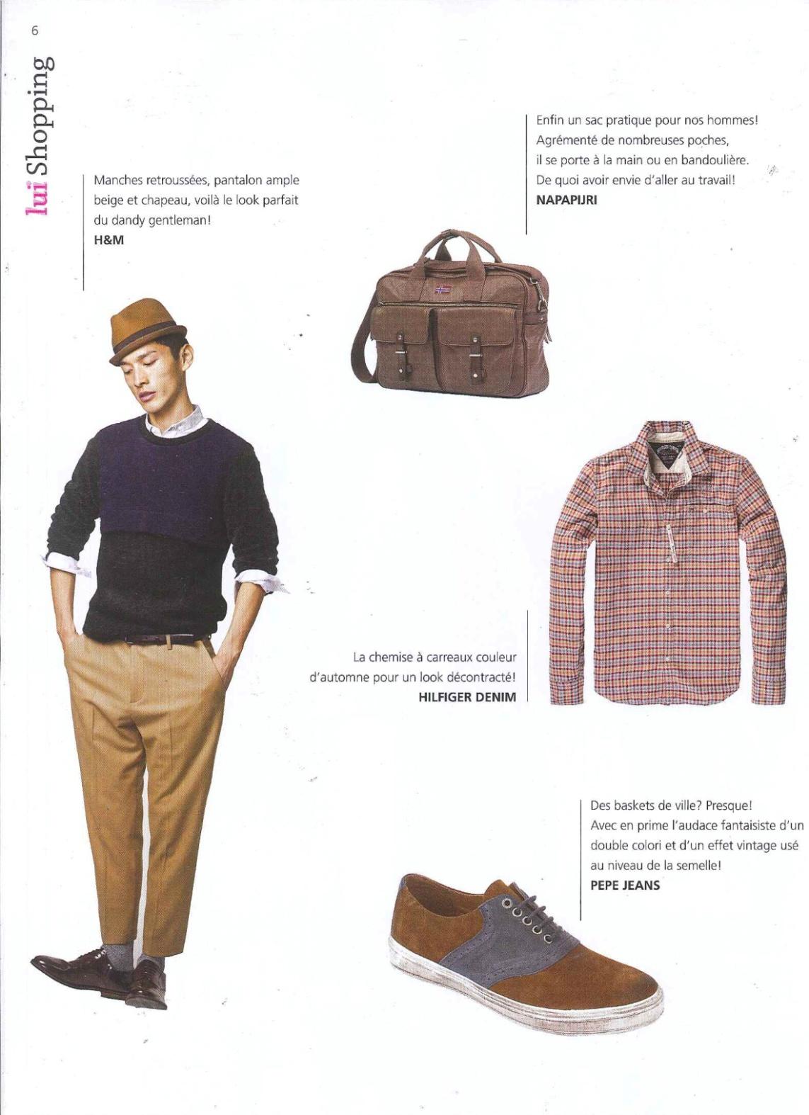
PUBLICATION : FEMMES magazine
ISSUE: SEPTEMBER
CIRCULATION:NC
PAGE RATE: NC
PRODUCT: BASKET

Slide 5
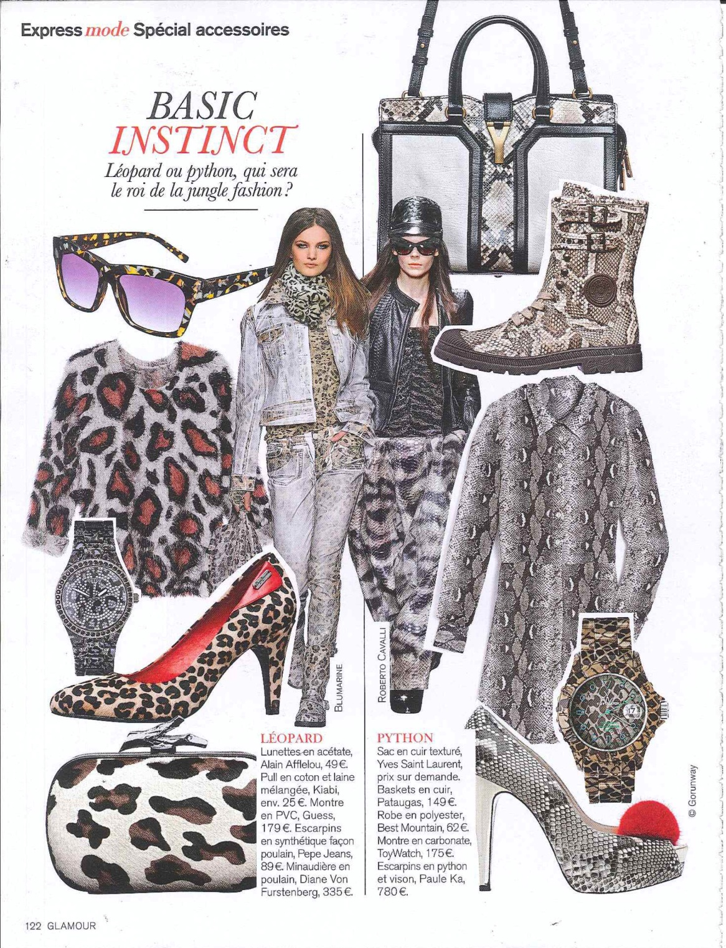
PUBLICATION : GLAMOUR
ISSUE: SEPTEMBER
CIRCULATION: 1 486 000
PAGE RATE: 25 000
PRODUCT: SHOES

Slide 6
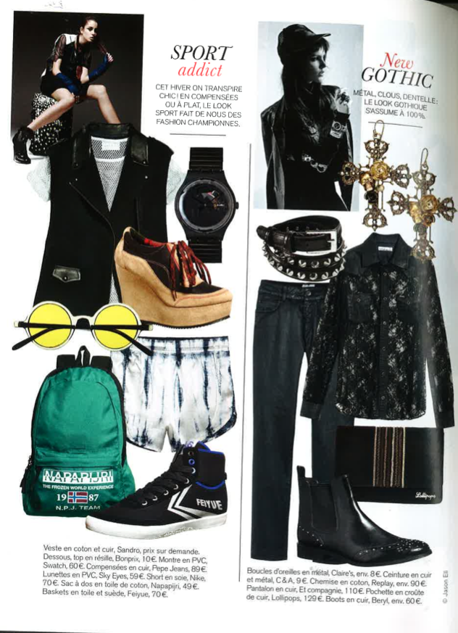
PUBLICATION : GLAMOUR
ISSUE: SEPTEMBER
CIRCULATION: 1 486 000
PAGE RATE: 25 000
PRODUCT: SHOES

Slide 7
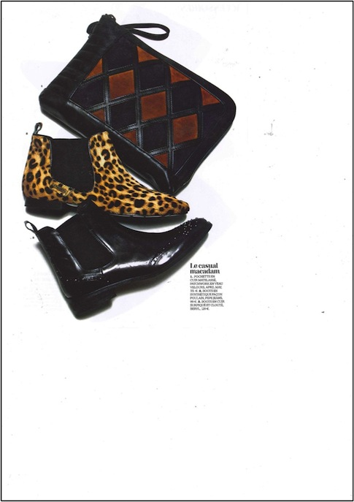
PUBLICATION : VOTRE BEAUTÉ
ISSUE: SEPTEMBER
PAGE RATE: 16 500
PRODUCT: SHOES

Slide 8
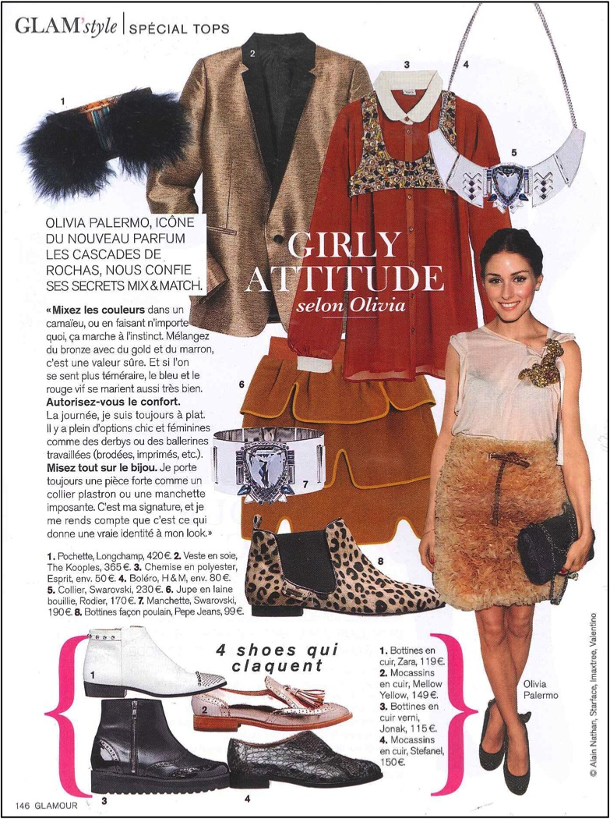
PUBLICATION : GLAMOUR
ISSUE: OCTOBER
CIRCULATION: 1 486 000
PAGE RATE: 25 000
PRODUCT: SHOES

Slide 9
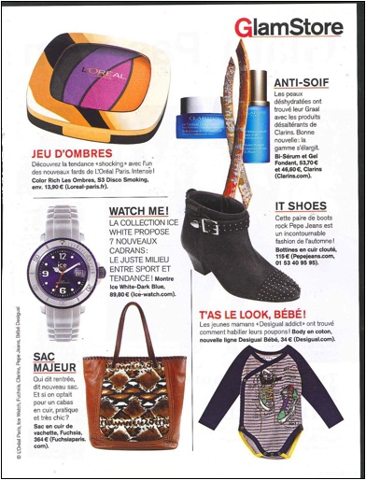
PUBLICATION : GLAMOUR
ISSUE: OCTOBER
CIRCULATION: 1 486 000
PAGE RATE: 25 000
PRODUCT: SHOES

Slide 10
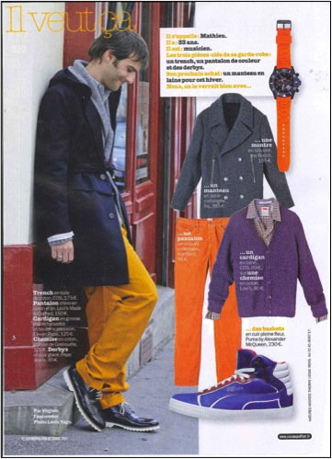
PUBLICATION : COSMOPOLITAN
ISSUE: OCTOBER
CIRCULATION:1 753 000
PAGE RATE: 27 500
PRODUCT: SHOES

Slide 11
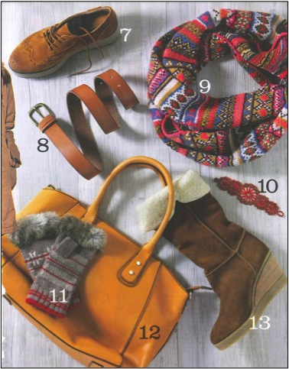
PUBLICATION : VERSION FEMINA
ISSUE : 1-7 OCTOBER
CIRCULATION : 4 531 000
PAGE RATE : 15 900€
PRODUCT : SHOES

Slide 12
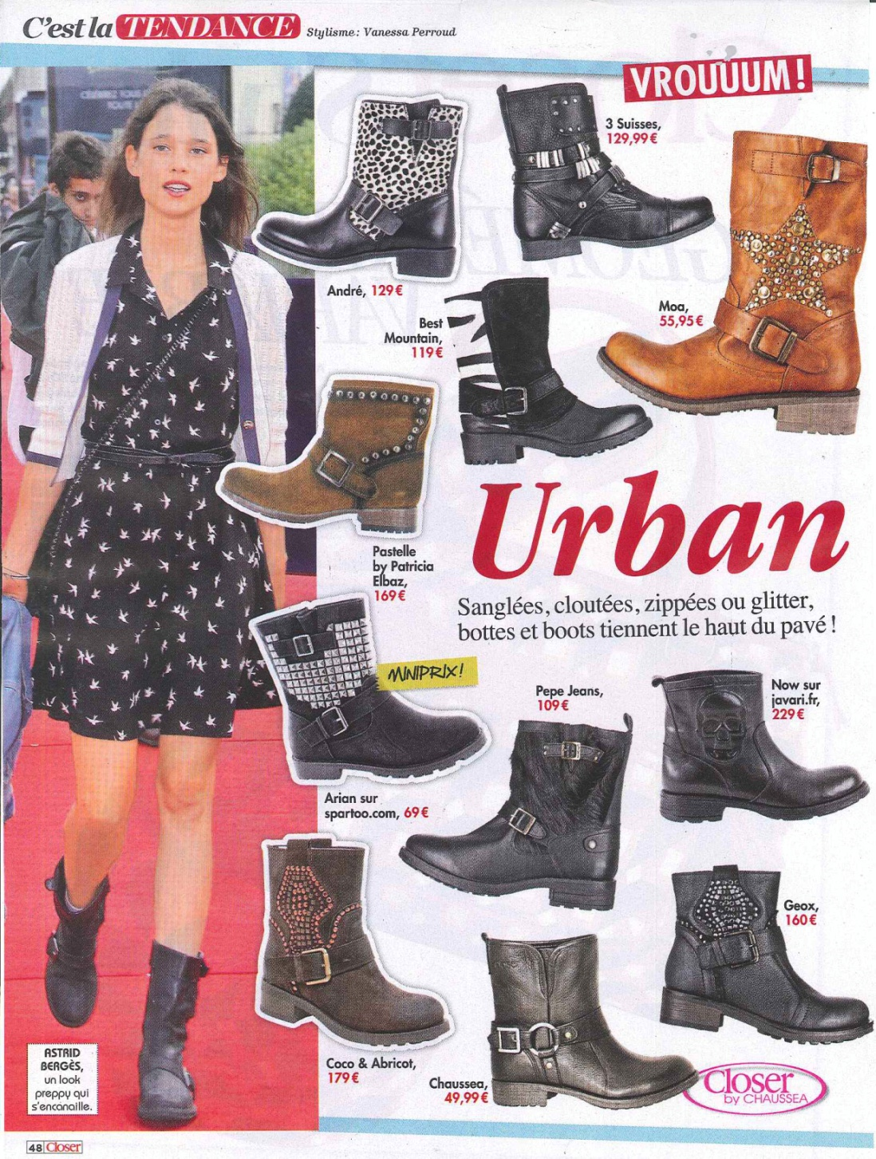
PUBLICATION : CLOSER
ISSUE: 6-12 OCTOBRE
CIRCULATION: 4 015 000
PAGE RATE: 16 500€
PRODUCT: BOOTS

Slide 13
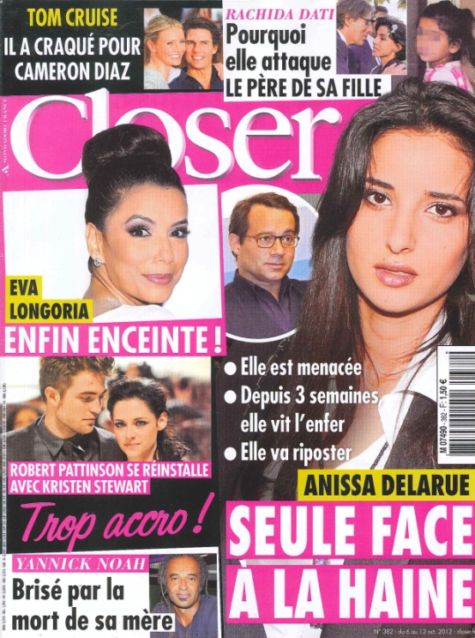
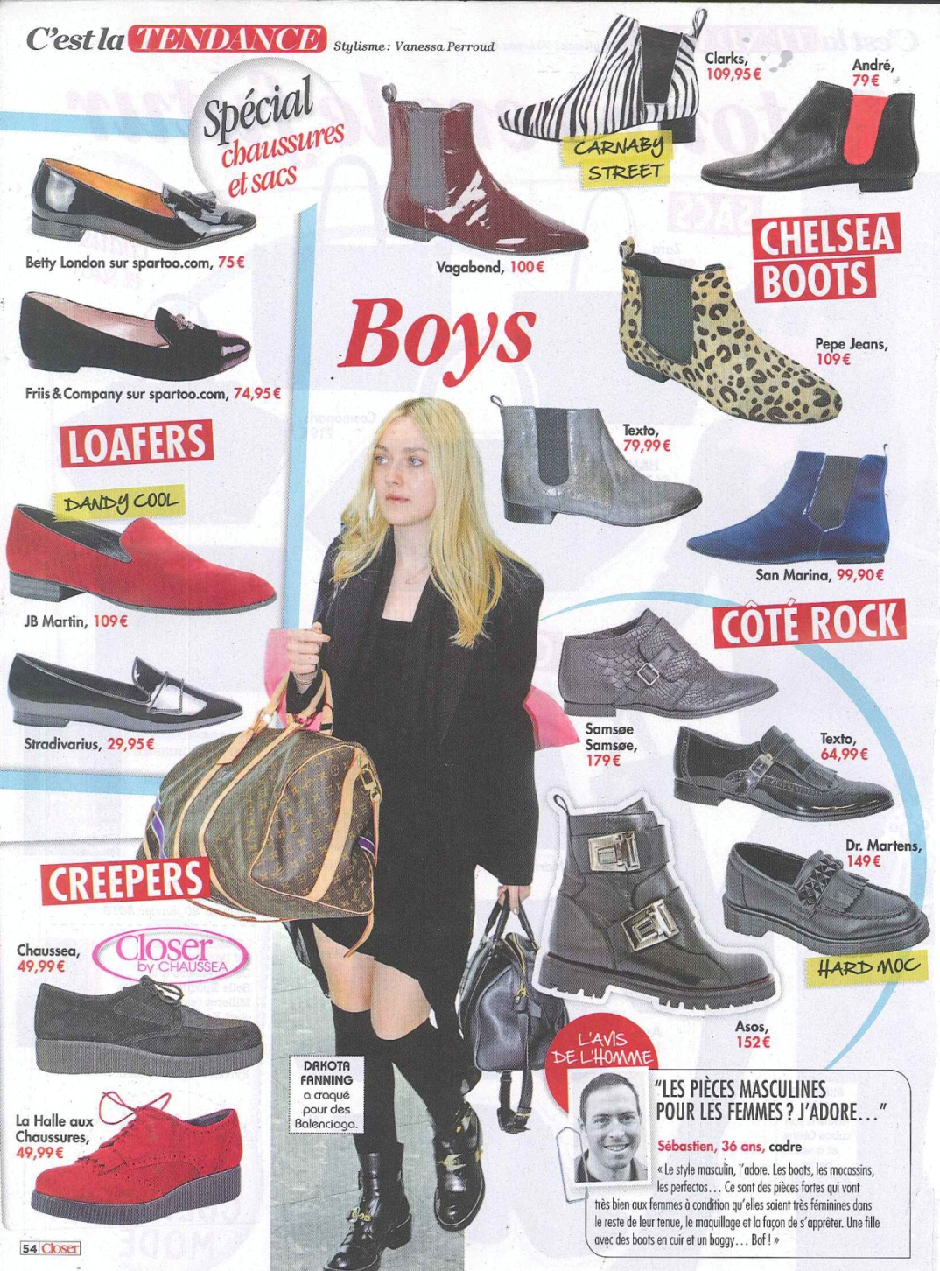
PUBLICATION : CLOSER
ISSUE: 6-12 OCTOBRE
CIRCULATION: 4 015 000
PAGE RATE: 16 500€
PRODUCT: BOOTS

Slide 14
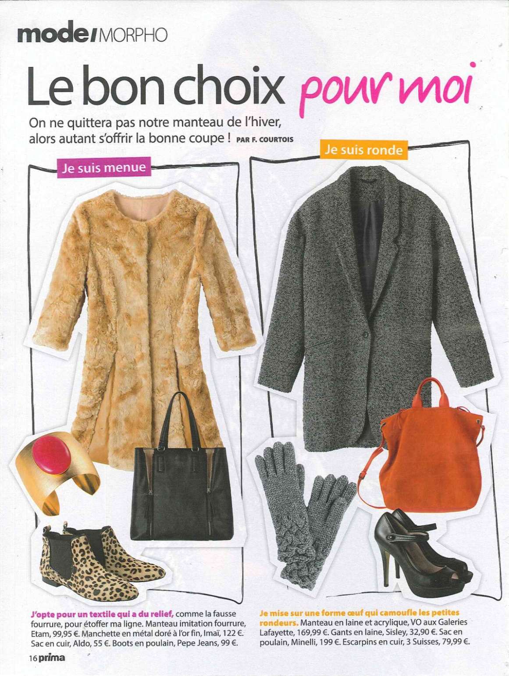
PUBLICATION : PRIMA
ISSUE: NOVEMBER
CIRCULATION: 2 548 000
PAGE RATE: 25 500€
PRODUCT: BOOTS

